Slide 1
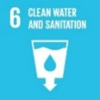
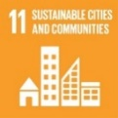
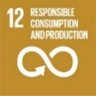
Ecological effects of microplastics in freshwaters
Carlos Silva (PhD Program in Biology and Ecology of Global Change)
Supervisors: João Pestana - Deparment of Biology
Carlos Gravato – University of Lisbon
​
Biology and Ecology of Global Change (BEGC) ​

Slide 2
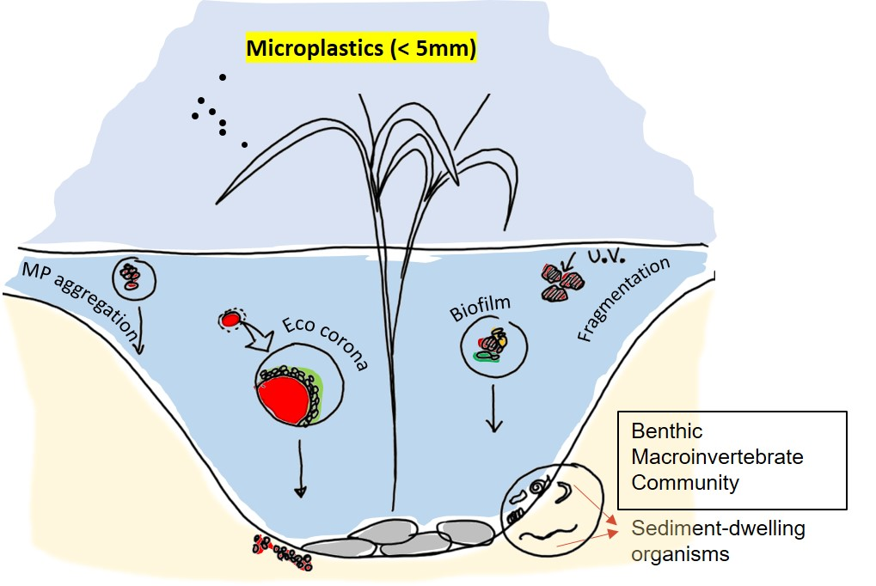
What is the problem?

Slide 3
Research challenges
Ingestion of microplastics (MPs) by freshwater benthic invertebrates
Life history and Biochemical responses
Accumulation and Transfer through the food chain
Role of MPs as vectors for contaminants
Toxicological effects combined with abiotic stressors (Temperature and Salinity)
Effects on natural benthic communities – Mesocosms tests (Artificial streams used to evaluate community / ecosystem level responses)

Slide 4
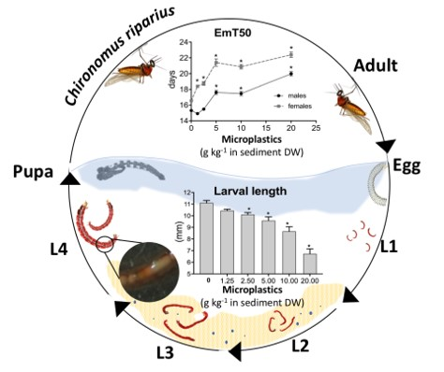
Results so far…
Life-history traits
Biochemical responses
Lipid damage
(LPO)
Impaired energy reserves (⬇lipids)
Energy
consumption (ETS)
⬇
Lumbriculus variegatus
(annelidae, detritivirous)

Slide 5
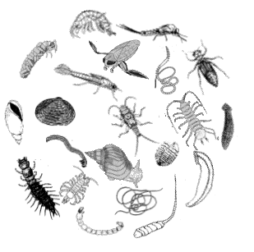
Current Impact
comPET project
ECOTOXICOLOGICAL EFFECTS OF MICROPLASTICS
ON FRESHWATER ENVIRONMENTS
https://competproject.weebly.com

